Slide 1
Redemption & Salvation

Slide 2
There is no difference between Jew and Gentile, for all have sinned and fall short of the glory of God
Romans 3:23
Notes:
We are all sinners. WE have all sinned.
Let’s review a little bit about Sin first

Slide 3
SIN has
COSTS
Sin Costs Man
Separation from God
Spiritual Death
“you shall surely die” Gen. 2:17
Driven out of the Garden = Out of the presence of God Gen. 3:24
Your iniquities have separated you from God and your sins have hidden his face from you… Isaiah 59:1-2

Slide 4
Notes:
This is a typical graphic that you can find online depicting what Sin does to our relationship with God.
What do you see here? Sin leads to death. Separates us from God. (Big Gap)
Today we want to start talking about what comes next.
THE END

Slide 5
Notes:
THE END>
This could be what happens.
Did this happen to Adam & Eve? kicked out of the garden. Relationship over.
For many people, this is what happens. But not because of GOD – because of them.
Fortunately, this was not God’s plan.

Slide 7
Notes:
I used this graphic because of this picture. It says a lot.
How are these people responding to the separation from God?
Leave – turn the other way, despondent.
Focus on themselves & their possessions – money, job, family – apathetic about the situation
Then – you have man filling in the gap – how are they attempting to do this? Deeds, good life, church, (man-based actions)
Will any of these work? NO. Gap is really large. Man cannot get there on His own.
Fortunately – God doesn’t expect man to restore the relationship with our own efforts.

Slide 8
Titus 1:1-2
Paul, a bondservant of God and an apostle of Jesus Christ, according to the faith of God’s elect and the acknowledgment of the truth which accords with godliness, in hope of eternal life which God, who cannot lie, promised before time began,
1 Tim 1:9
..who has saved us and called us with a holy calling, not according to our works, but according to His own purpose and grace which was given to us in Christ Jesus before time began,
REDEMPTION & Salvation
Notes:
HE provided JESUS. And Jesus Christ, our savior, is the one who bridges the gap (fills-in the gap) or connects us to God once again.
Click – GOD has provided a plan of Salvation – whereby He redeems us and restores our relationship.
-- could talk a lot about God doing this – He was the one wronged – but He put a plan together for us “while we were yet sinners’ Romans 5:8
BEFORE TIME BEGAN

Slide 9
Redemption
Notes:
Let’s talk today a bit more about REDEMPTION

Slide 10
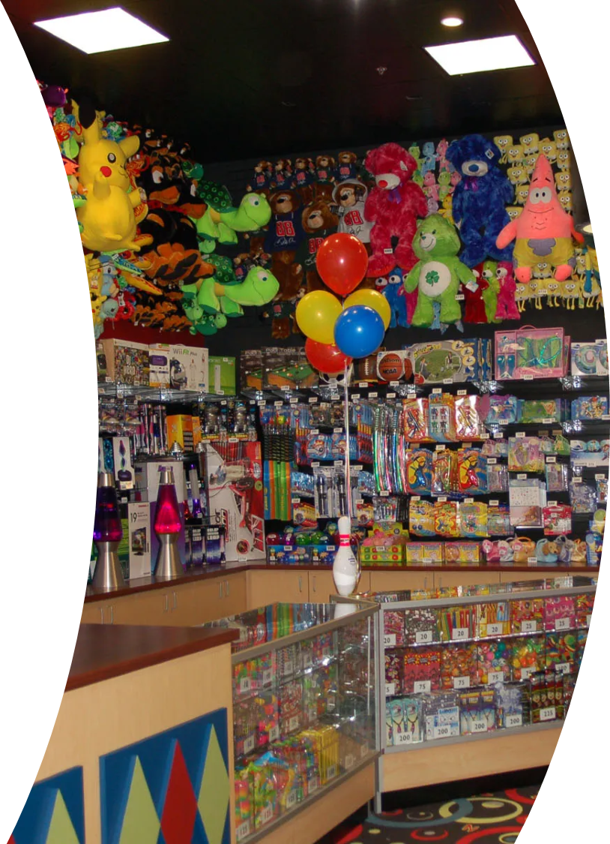
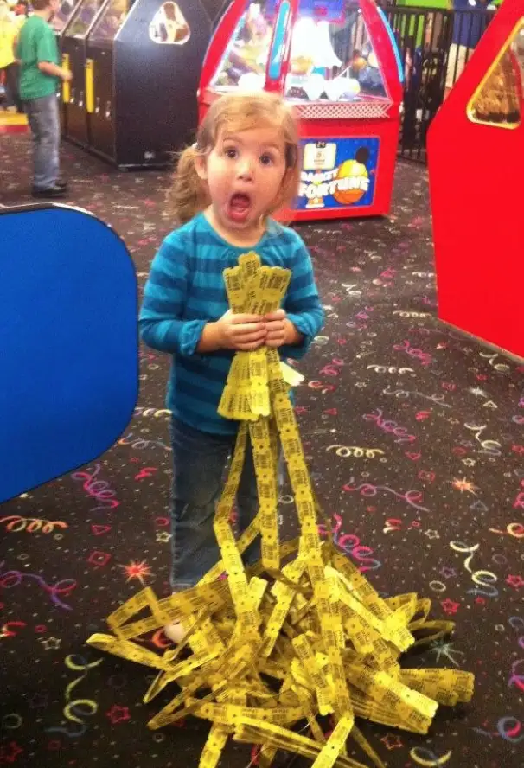
What is REDEMPTION?
the action of regaining or gaining possession of something in exchange for payment or clearing a debt.
Notes:
What do you think of when you hear “Redeem” or “Redemption”?
Is it only Biblically based thoughts? Redeeming is something I bet everyone has done
ACTION – EXCHANGING (something of value) – for PAYMENT – clearing a DEBT.

Slide 11
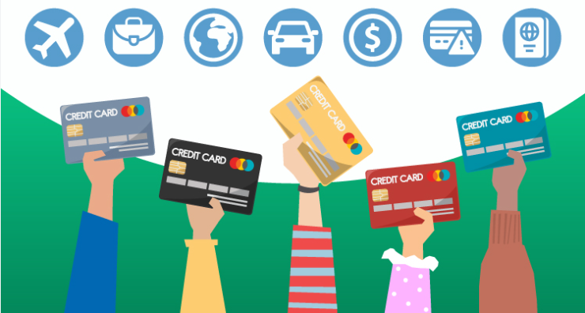
What is REDEMPTION?
the action of regaining or gaining possession of something in exchange for payment or clearing a debt.
Notes:
CREDIT CARDS – points, miles, etc. Flights, hotels, car rentals, cash back, amazon stuff – lots of types of credit card redemption.
Earned points (value) and you exchanged them (redeemed) them as payment for something else.
Going old school on you next.

Slide 12
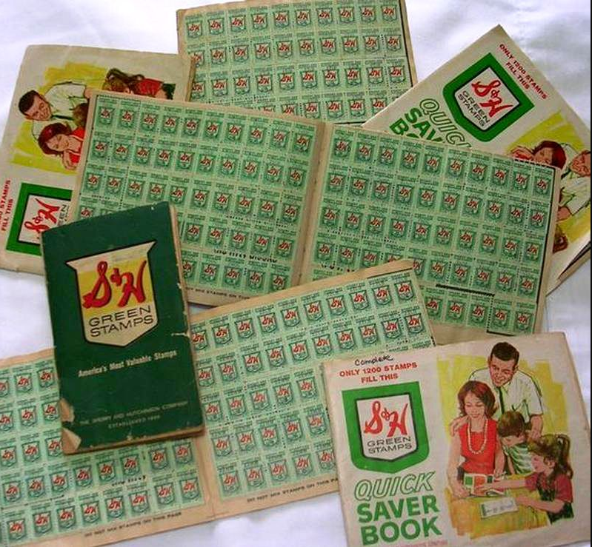
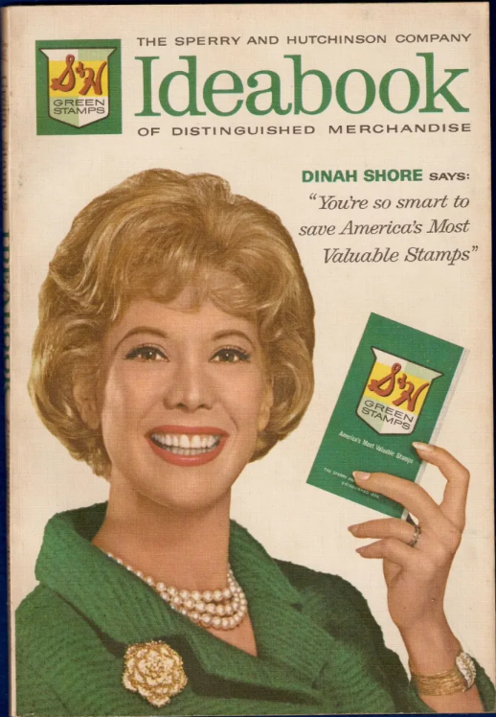
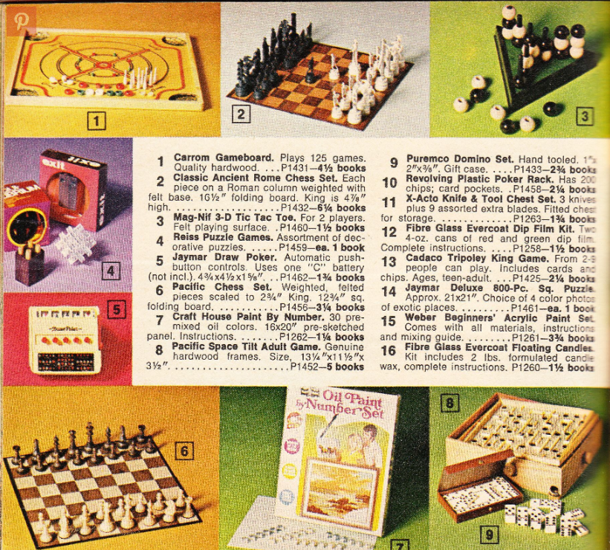
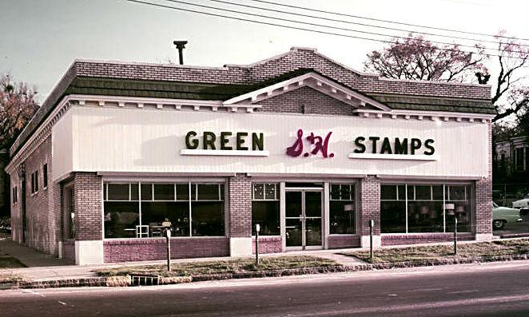
What is REDEMPTION?
the action of regaining or gaining possession of something in exchange for payment or clearing a debt.
Notes:
Have you ever heard of S&H GREEN STAMPS?
I always think of these when I hear the word “REDEEM”
Before credit card or store points. I helped my grandma lick and paste here stamps in books.
REDEEM the stamps for something else.

Slide 13
REDEMPTION: A DIVINE EXCHANGE
Notes:
We’re going to call our Redemption – a divine exchange for our class. I like adding this thought. It helps with the mental visual I think.
So – if we have a Divine Exchange – what do you think we need to be learning about this exchange? What do you want to know?
Who? What was exchanged? How much was exchanged? When did it happen? ETC.

Slide 14
REDEMPTION: A DIVINE EXCHANGE
WHO has been redeemed?
WHAT was the payment?
WHO made the payment?
WHEN was the payment made?

Slide 15
REDEMPTION: A DIVINE EXCHANGE
WHO is being Redeemed?
Sinners!
Why do sinners need Redeeming?
They do not belong to God. HE wants them back!
To whom do they belong?
Whoever commits sin also commits lawlessness, and sin is lawlessness; …. He who sins is of the devil, for the devil has sinned from the beginning….. Whoever does not practice righteousness is not of God, nor is he who does not love his brother.
1 John 3:4, 8, 10
Notes:
We are talking about WHO is being redeemed - SINNERS. They belong to Satan now.
Separated from God – this is what sins does. But fortunately, God has not made this an everlasting position for us.
Redemption is the process of God buying His people back from Satan!
Let’s talk about another concept before we start putting it all together. Next slide RANSOM

Slide 16
REDEMPTION
The payment for Redemption is called a RANSOM
Ransoms are expensive and come with specific instructions
.
Notes:
RANSOM – Biblical word for the payment for Redemption. What comes to mind?

Slide 17
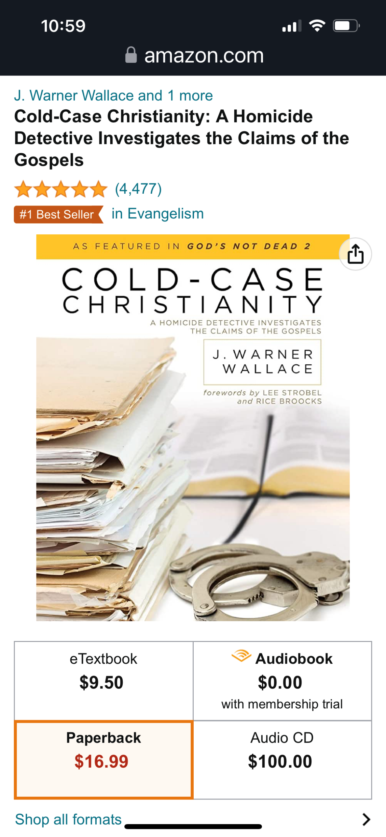

Slide 18
REDEMPTION
The payment for Redemption is called a RANSOM
Ransoms are expensive and come with specific instructions
.
Notes:
More modern version of a Ransom. Ransom-ware attacks. What happens here?
Very expensive, very specific instructions.

Slide 19
REDEMPTION: A DIVINE EXCHANGE
WHAT was the Ransom?
Very expensive!
More than what man could pay!
Truly no man can ransom another, or give to God the price of his life, for the ransom of their life is costly and can never suffice,
Psalm 49:7-8
Notes:
What was the Ransom – what can we assume about the Ransom?
Very expensive! YES. And it is more than Man can pay ourselves.
We are sinners and we cannot BUY or REDEEM ourselves back into God’s favor.

Slide 20
REDEMPTION: A DIVINE EXCHANGE
WHAT was the Ransom?
God requires Blood as payment for sins
Indeed, under the law almost everything is purified with blood, and without the shedding of blood there is no forgiveness of sins.
Hebrews 9:22
Notes:
The payment is BLOOD.
God requires BLOOD as the payment. Not freely given is it? Expensive, why?
GOD IS THE ONE REQUIRING THE PAYMENT (NOT SATAN) – Satan would never sell man back to God. This becomes a deeper discussion that we’ll have in this class – but God is the one demanding payment and specifying the payment (He did so before time, before man sinned).

Slide 21
REDEMPTION: A DIVINE EXCHANGE
WHAT was the Ransom?
God requires Blood as payment for sins
For the life of the flesh is in the blood, and I have given it for you on the altar to make atonement for your souls, for it is the blood that makes atonement by the life.
Leviticus 17:11
Notes:
Blood is required for forgiveness and atonement (reconciling).
The point is that God requires Blood. Does that seem weird?
(sin in the garden, naked, covered with animal skins, blood shed = ?)
Do you think God just enjoys watching blood be spilled? Animals bleed?
What is the significance of Blood? click

Slide 22
REDEMPTION: A DIVINE EXCHANGE
WHAT was the Ransom?
God requires Blood as payment for sins
Why blood? Blood = Life
(God’s Prerogative)
For the life of the flesh is in the blood, and I have given it for you on the altar to make atonement for your souls, for it is the blood that makes atonement by the life.
Leviticus 17:11
Notes:
Blood = LIFE.
God’s requirement for sin is a LIFE>
Garden = day you eat (sin), you shall surely die (spiritually).
Passage is from the Old Law.
Why did God choose this payment? His plan, His choice.
Israel offered sacrifices all year long for the atonement of their sins – so they could have a relationship with God.
Begs a question for us then!

Slide 23
REDEMPTION: A DIVINE EXCHANGE
But in these sacrifices there is a reminder of sins every year. For it is impossible for the blood of bulls and goats to take away sins.
Hebrews 10:3-4
Do we need to make Blood sacrifices?
No - Bulls & Goats were imperfect and insufficient
Sacrifices were a periodic reminder of the people’s sins
Notes:
Do we need to make sacrifices? Steven talked about the Law when we talked about sin. What did he say? Specific law for a specific time for a specific people.
Practice of sacrifice did not REMOVE (TAKE AWAY) sins.
“Rolled forward”
Reminder.

Slide 24
REDEMPTION: A DIVINE EXCHANGE
Therefore, the law was our tutor to bring us to Christ, that we might be justified by faith.
Galatians 3:24
Do we need to make Blood sacrifices?
No - Bulls & Goats were imperfect and insufficient
They were a periodic reminder of the people’s sins
Reminder continued until the perfect sacrifice was made

Slide 25
REDEMPTION: A DIVINE EXCHANGE
WHAT was the Perfect Sacrifice ‘to come’?
Blood was required
But not the blood of Bulls & Goats
Greater “Blood” was required for the forgiveness of mankind
Notes:
Greater “blood” = greater “life”
Perfect sacrifice.
If you are a Jew, what are you thinking? Perfect animal. Is that possible?
God had bigger plans - RANSOM is expensive!
Now we know a little more about Our Divine Exchange Payment. Too expensive for man – impossible to pay. No perfect sacrifice.
Who is going to pay?

Slide 26
REDEMPTION: A DIVINE EXCHANGE
WHO made the payment?
Was it another man?
Truly no man can ransom another, or give to God the price of his life, for the ransom of their life is costly and can never suffice,
Psalm 49:7-8
Notes:
Who paid? Another man? NOPE>
Same thought: too costly.

Slide 27
REDEMPTION: A DIVINE EXCHANGE
WHO made the payment?
Was it another man?
What could a man give?
Or what will a man give in exchange for his soul?
Matt 16:26
Notes:
Anyway – what is the most a man can give? Everything – still not enough.

Slide 28
REDEMPTION: A DIVINE EXCHANGE
WHO made the payment?
Was it another man?
What could a man give?
GOD made the payment with the perfect sacrifice
Christ was offered once to bear the sins of many.
Hebrews 9:28
Notes:
WE know the answer: God made the payment on our behalf.
Wow – as the sacrificial lambs symbolically bore the sins of man (for a year); Christ was offered to bear the sins of many!

Slide 29
REDEMPTION: A DIVINE EXCHANGE
WHO made the payment?
GOD made the payment with the perfect sacrifice
Behold! The Lamb of God who takes away the sin of the world!
John 1:29
Notes:
God sent a perfect LAMB. There was a perfect animal sacrifice! Jesus was perfect! He was the Lamb of God.

Slide 30
REDEMPTION: A DIVINE EXCHANGE
WHO made the payment?
GOD made the payment with the perfect sacrifice
For God so loved the world that He gave His only begotten Son, that whoever believes in Him should not perish but have everlasting life.
John 3:16
Notes:
Why did God make the payment

Slide 31
REDEMPTION: A DIVINE EXCHANGE
WHO made the payment?
God made the payment with the perfect sacrifice
God gave His Son as payment!
God redeemed Man through Jesus’ Blood (Death)
But now in Christ Jesus you who once were far off have been brought near by the blood of Christ.
Ephesians 2:13
Notes:
Now we know the cost (ransom), we know who paid (God) – and we kinda know when the payment was made – but let’s look more at this so can see what the Bible has to say about this payment.

Slide 32
REDEMPTION: A DIVINE EXCHANGE
WHEN was payment made?
When innocent blood was shed
He has delivered us from the power of darkness and conveyed us into the kingdom of the Son of His love, in whom we have redemption through His blood, the forgiveness of sins.
Colossians 1:13
Notes:
Did the blood need to be innocent? Yes, pure, perfect.
We have redemption (price is paid) through Jesus Blood.
Delivered from Darkness.

Slide 33
REDEMPTION: A DIVINE EXCHANGE
WHEN was payment made?
When innocent blood was shed
When an innocent life was taken
For Christ also suffered once for sins, the just for the unjust, that He might bring us to God, being put to death in the flesh but made alive by the Spirit,
1 Peter 3:18
Notes:
Innocent blood = innocent life. When Jesus was put to death – blood payment was made –
The “just’ for “unjust” = perfect for the imperfect.

Slide 34
REDEMPTION: A DIVINE EXCHANGE
WHEN was payment made?
When innocent blood was shed
When an innocent life was taken
When the perfect sacrifice was made
Knowing that you were not redeemed with perishable things like silver or gold from your futile way of life inherited from your forefathers, but with precious blood, as of a lamb unblemished and spotless, the blood of Christ.
Colossians 1:13
Notes:
Innocent blood & life made the perfect sacrifice.
Not redeemed with things man might have – only the precious blood – unblemished, spotless blood of Jesus Christ.
LAST SLIDE FOR TODAY

Slide 35
REDEMPTION: A DIVINE EXCHANGE
“The central theme of redemption in Scripture is that God has taken the initiative to act compassionately on behalf of those who are powerless to help themselves. The New Testament makes clear that divine redemption includes God's identification with humanity in its plight, and the securing of the liberation of humankind through the obedience, suffering, death, and resurrection of the incarnate Son.” (Excerpted from Baker’s Evangelical Dictionary of Biblical Theology)

Slide 36
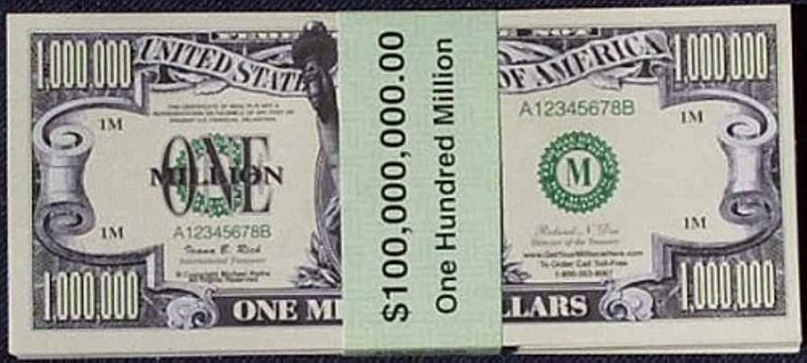
Who would like a piece of gum?
$100,000,000
per cube
Notes:
Most special gum – never get sick, always strong. Ransom (price) very expensive – beyond man’s normal reach.
God will give us the gum. (eternal life) – but we can’t afford it – so he has paid the price for the gum for us. It’s His gum, He wants us to have it and He has paid for it. OH but there is a CATCH. You have to go pick it up at the CVS. That is redemption.

Slide 37
REDEMPTION: A DIVINE EXCHANGE

Slide 38
Redemption & Salvation
Notes:
Talked about Redemption, second part of the class is Salvation.
Redemption is buying back or an exchange. Blood for Life.
Salvation is related but different. VICE DITTO.

Slide 39
What is SALVATION?
Biblically, salvation refers to the act of being saved from the eternal consequences of sin.
Salvation is similar to Redemption. It is being rescued by God from the effects of sin, which is spiritual death.
Notes:
What is salvation? Root word: save
What does that imply? Have we discussed that already? Yes, we are of the devil’s kingdom when we are living in Sin.
Salvation is similar to Redemption – but different. VICE DITTO.
Man is rescued by God is the central theme to both. But two ways of looking at it.
Redemption buys man’s freedom. Salvation rescues man from sure death.

Slide 40
Notes:
Who has heard of the ROMANS ROAD TO SALVATION?
A collection of passages in Romans that provide the overview and God’s plan for salvation.
There are a number of these ‘so called’ Romans Road to Salvation published. Many aren’t exactly right.
I’ve gone through some and put together what I believe is an accurate road.

Slide 41
Wrong Roads: Lead to the Wrong Destination
Matthew 7:13-14
Enter by the narrow gate; for wide is the gate and broad is the way that leads to destruction, and there are many who go in by it. Because narrow is the gate and difficult is the way which leads to life, and there are few who find it.
Notes:
Whenever we get on a road, what do we always check? Confirm the destination.
“Are we on the right road?” How do you know?
Biblically speaking – we have to study and evaluate to make sure we are on the right road.
Romans Roads to Salvation are many if you search the internet. But there is only One Road. So we have to look at all the guide posts and markers to make sure we are on the right road.

Slide 42
The Problem: ALL ARE SINNERS
Romans 3:10
As it is written: “There is none righteous, no, not one;
Romans 3:23
For all have sinned, and come short of the glory of God
Notes:
Romans road starts where we did in the last couple of lessons. LOST. We are all LOST. Sinners need a way.

Slide 43
The PRICE of SIN is DEATH
Romans 5:12 NLT
When Adam sinned, sin entered the world. Adam’s sin brought death, so death spread to everyone, for everyone sinned.
Romans 6:23
For the wages of sin is death, but the gift of God is eternal life in Christ Jesus our Lord
Notes:
We are so LOST we are headed for sure death. If we are simply driving blindly – walking without purposes – we have little hope and the result of wandering and following our own way is death.

Slide 44
GOD sent Jesus to Save Us
Romans 5:8
But God showed His great love for us by sending Christ to die for us while we were still sinners.
Notes:
Help is on the Way! Actually while we were lost (still sinners) – before we even knew we needed saving – God sent His Son to rescue us.
Jesus came to die in our place! So we could live! AMAZING!!

Slide 45
That is GOOD NEWS!
Romans 1:16
For I am not ashamed of the Gospel of Christ, for it is the power of God to Salvation for everyone who believes, for the Jew first and also to the Greek.
Notes:
That whole story of man being lost, but God willing to Save Him (at God’s own cost) is GOOD NEWS!
It is the GOSPEL! (means Good News)

Slide 46
Rescue ME, TOO?
Romans 10:11-13
For the scripture says, WHOEVER believes on HIM will not be put to shame. For there is no distinction between Jew and Greek, for the same Lord over all is rich to all who call upon Him. For WHOEVER calls on the name of the Lord shall be Saved.
Notes:
But is He going to rescue me too? Depends – do you believe He will? He will gladly do it, but you need to believe it.
And you need to do something as well . You need to call out to HIM!!

Slide 47
Rescue ME, TOO?
Matthew 7:21
“Not everyone who says to Me, ‘Lord, Lord,’ shall enter the kingdom of heaven, but he who does the will of My Father in heaven. .
Notes:
But is He going to rescue me too? Depends – do you believe He will? He will gladly do it, but you need to believe it.
And you need to do something as well . You need to call out to HIM!! And that means doing what He says!

Slide 48
GREAT! Tell me MORE!
Romans 10:17
So, then FAITH comes by hearing, and hearing by the WORD OF GOD
Notes:
But how can I know He is willing to help me?
He tells us in many places and in many ways what HIS plan is.
We just need to ready about it!

Slide 49
Do you Believe? Say So!
Romans 10:9-10
…that if you confess with your mouth the Lord Jesus and believe in your heart that God has raised Him from the dead, you will be saved. For with the heart one believes unto righteousness, and with the mouth confession is made unto salvation.
Notes:
OK. Got it. Now what?
Let Him know. Let other know.

Slide 50
No Worries then, I’ll Head Wherever!
Romans 6:1
What shall we say then? Shall we continue in sin that grace may abound? Certainly not!
Notes:
Can we just keep going wherever and doing whatever? God’s got me? He’ll save me wherever I go – whatever I do. Right?

Slide 51
Walk a NEW LIFE!
Romans 6:4
Therefore, we were buried with Him through BAPTISM into death, that just as CHRIST was raised from the dead by the glory of the Father, even so we also should walk in newness of life!
Notes:
We are lost and ‘dead-men’ walking. But Christ has the power to raise us from the Dead.
We are raised to a new life / new plan / a new way / through baptism.
Then we walk in NEWNESS OF LIFE!

Slide 52
Enjoy PEACE with GOD
Romans 5:1
Therefore, having been justified by faith, we have PEACE with GOD through our Lord Jesus Christ.
Notes:
WOW = that makes me feel good! So peaceful to know that Jesus is with me and my walk is the RIGHT WAY

Slide 53
WALK a NEW LIFE
Romans 5:1
Therefore, having been justified by faith, we have PEACE with GOD through our Lord Jesus Christ.

Slide 54
WALK a NEW LIFE
Romans 5:1
Therefore, having been justified by faith, we have PEACE with GOD through our Lord Jesus Christ.

Slide 55
No Turning BACK
Romans 8:1
There is therefore now no condemnation to those who are in Christ Jesus…

Slide 56
Be FREE from SATAN’S control
Romans 8:38-39
For I am persuaded that neither death nor life, nor angels, nor principalities, nor powers, nor things present nor things to come , nor height nor depth, nor any other created things, shall be able to separate us from the lover of God which is in Christ Jesus our Lord.

Slide 57
What about those who lived before Jesus?
IMPUTED = CREDITED
The righteousness of Christ is imputed to them that believe in him, or so attributed to them as to be considered their own
Who needed Imputed righteousness?
What does it take to have IMPUTED righteousness? Romans 4:3; 20-22;
What about US? Romans 4:23-25

